Slide 1

Enhanced Natural Language Interaction Platform with offensive content filtering
Shubham Patil (22106047)
Yuvraj Tiwari (22106061)
Project Guide
Prof. Darshana B.

Slide 2
Outline
Introduction
Literature Survey of the existing systems
Limitations of the existing systems
Problem statement and Objective
Proposed System
Experimental Setup(Details about input/ dataset, Performance evaluation parameters, Software and hardware setup)
Implementation(Screenshots of all modules)
Conclusion and future work
References

Slide 3
Introduction
The Digital Communication Challenge: In today's digital age, the convenience of chat applications is often undermined by the prevalence of inappropriate content, such as vulgarity, hate speech, and irrelevant messages.
Motivation: This project is motivated by the observation that many widely-used chat platforms lack effective, real-time mechanisms to prevent such harmful content from being sent, creating disruptions in professional environments and potential legal repercussions.

Slide 4
Objective
Project Objective: The core objective is to develop an intelligent chat application that addresses this gap. The system is designed to enhance the quality of professional communication by proactively detecting and blocking offensive messages before they are delivered.
Technological Approach: By leveraging Natural Language Processing (NLP) and machine learning and Deep Learning algorithms, the application will identify inappropriate content, including slang and abusive language, and either block or replace it with suitable alternatives, ensuring respectful and professional interactions.
Contribution to UN Sustainable Development Goals(SDGs)
1) SDG Goal 16: Peace, Justice and Strong Institutions
Detects and blocks hate speech, abusive content, and cyberbullying in real-time.
Promotes safe, respectful, and peaceful communication in digital platforms.
Supports ethical AI to reduce online conflict and harassment

Slide 5
Literature Survey of the existing system
Sr no | Paper Title | Author | Summary | Limitation
1. | Analysis of Behavior in Chat Applications using NLP (2024) | Shiny J., Penyameen S., Hannah N., Harilakshmi J.S., Hewin A., Thanusha S. | Existing parental tools give only basic reports; lack real-time & advanced behavior analysis. | No real-time analysis, delayed response, unable to detect subtle risks
2. | AI Enhanced Customer Service Chatbot (2024) | Mahesh V. Korde, Shivam R. Varma, Pritesh N. Bhalerao, Tanvir T. Shaikh, Atharv A. Sonawane. | AI chatbot provides 24/7 personalized support using NLP/ML, increasing satisfaction and decreasing response time. | Requires high computational cost, complex setup, resource-intensive training, and continuous model updates.
3. | Secure Chat Room Application Using AES-GCM Encryption (2023) | Muhammad Faisal Nawaz, Yasir Nawaz | Uses AES-GCM to secure chatroom, ensures high reliability and zero breaches. | Uses AES-GCM to secure chatroom, ensures high reliability and zero breaches. No real-time analysis for contents messages.

Slide 6
Sr no | Paper Title | Author | Summary | Limitation
4. | Professional Chat Application based on NLP (2024) | S. Karthick, R. J. Victor, S. Manikandan, Bhargavi Goswami | NLP app improves workplace chat, cuts inappropriate content by ~78%. | Dictionary-based, needs manual updates, context errors, may filter too much.
5. | Automated Toxic Chat Synthesis, Reporting and Removing the Chat in Telegram Social Media Using NLP Techniques | A B and P. Prithvi | Addresses toxicity in Telegram chats using NLP. Classifies toxic content and automates reporting & removal using ML models like Logistic Regression, KNN, Random Forest, Naive Bayes, BERT. | No real-time analysis, delayed response, unable to detect subtle risks in live environment.
6. | Toxicity Tweet Detection and Classification Using NLP Driven Techniques | K. Pal and S. Rai | Detects and classifies tweet toxicity using NLP with ML and deep learning models like LSTM achieving 90.7% accuracy and F1-score 0.94. | delayed response, unable to detect subtle risks.

Slide 7
Limitations in Existing Systems:
Report dependent: Existing systems are largely reactive, depending on user reports. They lack real-time, proactive filtering and struggle to understand the context and nuance of human language (e.g., sarcasm).
Problem Complexity: The issue of online toxicity is far from being completely solved. The dynamic and evolving nature of language means simple keyword-based solutions are perpetually outdated and ineffective.
Improvement Possibilities: A significant opportunity exists for a system that not only blocks harmful content but also offers corrective actions, such as replacing slang with professional language to improve communication clarity.
Performing Methodologies: While complex deep learning models offer high accuracy, our analysis suggests that efficient machine learning models like Logistic Regression, combined with a robust NLP pipeline (e.g., TF-IDF), provide a better balance of speed and accuracy for real-time chat applications.
Justification for Contribution: We are confident in addressing these limitations. By creating a proactive moderation system that is both fast and intelligent, this project offers a tangible contribution to solving the problem of online toxicity and fostering safer digital environments. This justification provides the foundation for our proposed system.

Slide 8
Problem Statement
Chat applications are widely used for personal, educational, and professional communication. However, most platforms struggle to manage inappropriate content effectively. Current moderation methods, like manual review or basic keyword filters, are outdated and insufficient. This leads to disrupted communication, user dissatisfaction, and potential legal risks. There is a clear need for smarter, scalable, and context-aware moderation systems.

Slide 9
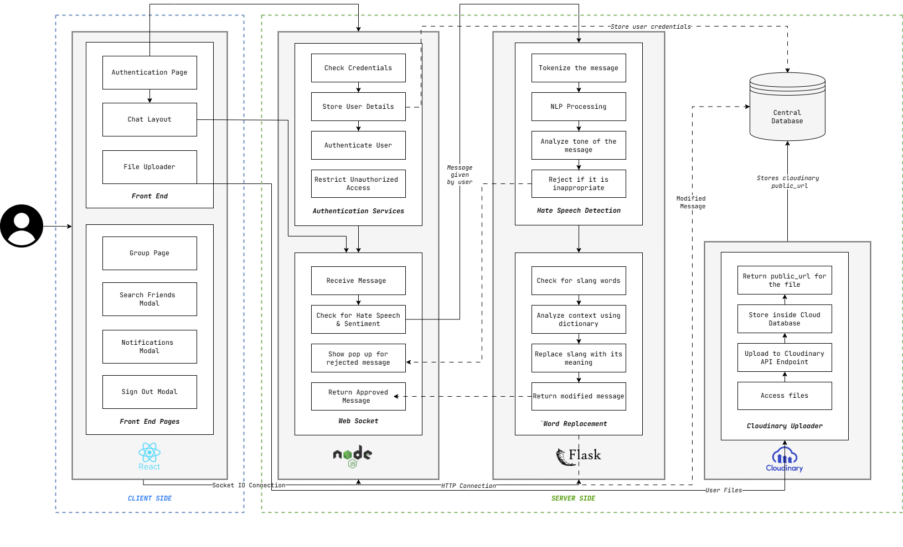
System Design

Slide 10
Technologies and methodologies
Frontend (React)
Provides authentication, chat interface, file upload UI.
Connects with backend services using WebSocket and REST APIs.
Authentication (Node.js)
Validates credentials securely.Uses JWT-based session handling.
Stores/retrieves user credentials in the central database.
Real-Time Messaging (WebSocket - Node.js)
Enables instant two-way communication between users.
Routes each message through NLP services before delivery.
Hate Speech Detection & Word Replacement (Flask + NLP)
Preprocessing: Tokenization, stopword removal.
Hate Speech Detection: Sentiment analysis + toxicity classification.
File Upload & Storage (Cloudinary)
Files are uploaded via Cloudinary API endpoint.
Public URL is generated and stored in the central database.
Supports fast retrieval and sharing in chat.
Database(MongoDB)
Maintains user profiles, credentials, chat history, file metadata. Ensures consistency across authentication, messaging, and file storage.

Slide 11
Deep Learning Models:
CNN (custom embeddings): Acc 85.88%, F1 86.48%, Toxic F1 70.9%, ROC-AUC 92.5%, Inference 11.2k/s
LSTM+Attention: Acc 83.6%, F1 84.6%, Toxic F1 68.2%, ROC-AUC 91.2%, Inference 150/s (slow, inefficient)
Enhanced TextCNN (GloVe): Acc 81.1%, F1 82.6%, Toxic Recall 89.9%, ROC-AUC 92.3%, Inference 9.3k/s
CNN-GRU Hybrid: second Best : Acc 87.4%, F1 87.7%, Toxic F1 72.4%, ROC-AUC 93.0%, Inference 20.9k/s (fastest, balanced)
DistilBERT finetuned: Acc 90.47% F1 90.40% Toxic Recall 77.10%
ROC-AUC 95.29%
Ensable of DistilBERT and CNN-GRU Hybrid: Acc 92.79 F1 92.74
Toxic Recall 82.67 ROC-AUC 97.04

Slide 12
Experimental setup
Dataset:
Source: MetaHate Benchmark (2024) – curated by IRLab
Content: Combines 36 English hate speech datasets from different domains (Twitter, Reddit, news comments, etc.)
Size: Hundreds of thousands of labeled comments/posts aggregated
1.1million records
Purpose: Provides a unified benchmark for training and testing hate speech detection models
Language : Python
Eviornment : Kaggle P100 GPU

Slide 13
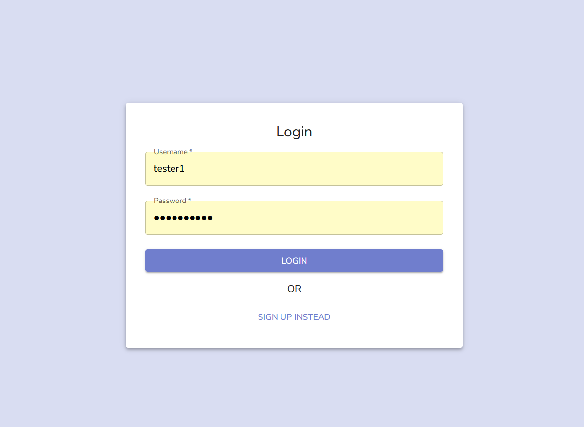
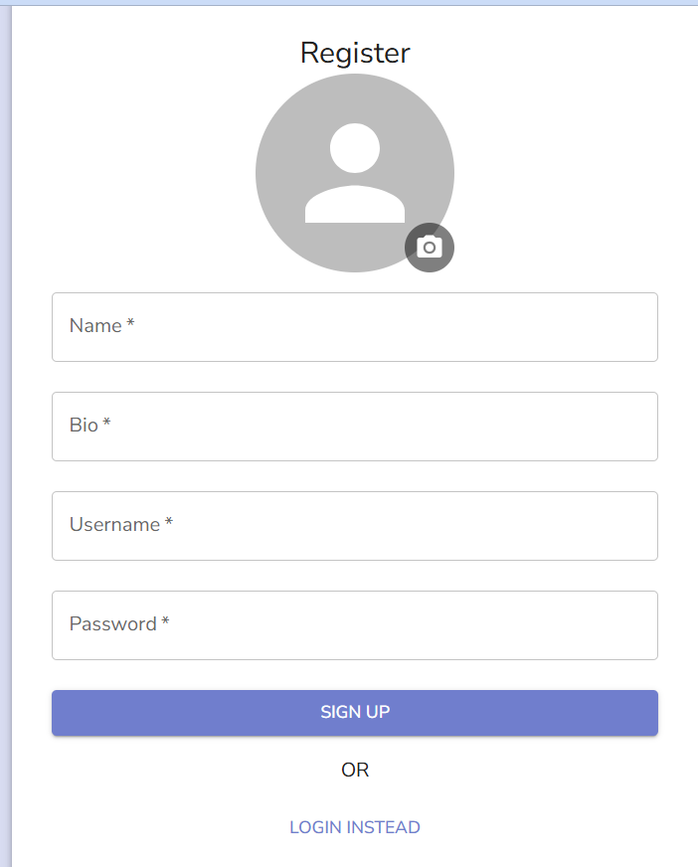
Implementation

Slide 14
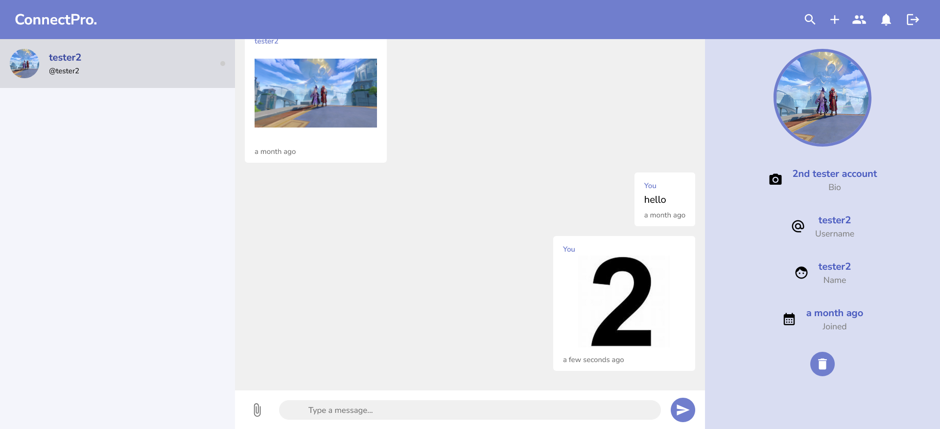
Implementation

Slide 15
Model Performance Comparison:
Model | Accuracy | F1-Score (Weighted) | F1 (Toxic) | Toxic Recall | Toxic Precision | ROC-AUC | Training Time | Inference Speed
Ensemble of Distilbert and CNN-GRU | 92.79 | 0.9274 | 0.8267 | 0.8121 | 0.8419 | 0.9704 |  | 86 samp/s
DistilBERT | 90.47% | 90.40% | 77.10% | 75.74% | 78.51% | 95.29% | 283.7 min | 86 samp/s
CNN-GRU | 87.35% | 87.68% | 72.40% | 64% | 82% | 92.96% | 19.8 min | 20,920 samp/s
Linear SVM | 86.47% | 85.81% | 64.00% | 57% | 73% | 90.50% | 2-3 min | 50,000+ samp/s
Logistic Regression | 86.25% | 85.43% | 62.00% | 54% | 74% | 90.20% | 1-2 min | 60,000+ samp/s
GPU CNN | 85.88% | 86.48% | 70.88% | 63% | 80% | 92.50% | 10.9 min | 11,224 samp/s
LightGBM | 85.19% | 83.88% | 58.00% | 47% | 74% | 89.80% | 3-5 min | 30,000+ samp/s
XGBoost | 85.17% | 83.52% | 56.00% | 43% | 76% | 89.50% | 5-8 min | 25,000+ samp/s
Naive Bayes | 83.76% | 83.46% | 60.00% | 57% | 63% | 88.00% | <1 min | 80,000+ samp/s
LSTM+Attn | 83.60% | 84.55% | 68.21% | 60% | 78% | 91.24% | 141.3 min | 150 samp/s
ToxicBERT | 83.20% | 83.65% | 63.37% | 56% | 72% | 87.51% | 250+ min | 86 samp/s
TextCNN (GloVe) | 81.12% | 82.58% | 66.86% | 59% | 76% | 92.33% | 10.2 min | 9,387 samp/s

Slide 16
Conclusion
The project delivers a powerful solution combining NLP and AI to foster safe digital conversations. Its real-time filtering, slang replacement features offer enhanced communication for users in professional and educational domains.x

Slide 17
References
[1] J. S. J, P. K, H. N. M, H. JS, H. A and T. S, "Analysis of Behavior in Chat Applications using Natural Language Processing," 2024 2nd International Conference on Sustainable Computing and Smart Systems (ICSCSS), Coimbatore, India. [2] Y. A. Rani, A. Balaram, M. R. Sirisha, S. A. Nabi, P. Renuka and A. Kiran, "AI Enhanced Customer Service Chatbot," 2024 International Conference on Science Technology Engineering and Management (ICSTEM), Coimbatore, India. [3] G. J. Babu, S. Safrinfathima, K. D. Reddy and S. K. Sen, "Transforming Human-Machine Interaction: Generative AI Virtual Asst," 2024 International Conference on Knowledge Engineering and Communication Systems (ICKECS), Chikkaballapur, India. [4] A. A B and P. Prithvi, "Automated Toxic Chat Synthesis, Reporting and Removing the Chat in Telegram Social Media Using Natural Language Processing Techniques," 2024 Fourth International Conference on Advances in Electrical, Computing, Communication and Sustainable Technologies (ICAECT), Bhilai, India.

Slide 18
[5] S. Tirpude, Y. Thakre, S. Sudan, S. Agrawal and A. Ganorkar, "Mining Comments and Sentiments in YouTube Live Chat Data," 2024 4th International Conference on Intelligent Technologies (CONIT), Bangalore, India. [6] G. A, M. D. C, S. r. S J, P. P, A. M and S. A, "Voice Assistant with AI Chat Integration using OpenAI," 2024 Third International Conference on Intelligent Techniques in Control, Optimization and Signal Processing (INCOS), Krishnankoil, Virudhunagar district, Tamil Nadu, India.
[7] M. Alkhyeli, S. Alkhyeli, K. Aldhaheri and H. Lamaazi, "Secure Chat Room Application Using AES-GCM Encryption and SHA-256," 2023 15th International Conference on Innovations in Information Technology (IIT), Al Ain, United Arab Emirates. [8] M. Thenmozhi, K. P. R. Rohit, A. S and S. Chakkravarthi D, "Chat Master Using DJANGO," 2023 IEEE Engineering Informatics, Melbourne, Australia. [9] S. Singh, S. Singh and A. Sharma, "Real-Time Secure Web-Based Chat Application using Django," 2023 5th International Conference on Advances in Computing, Communication Control and Networking (ICAC3N), Greater Noida, India. [10] A. Anand, R. Subha, S. Rajan, N. Bharathi and A. K. Srivastava, "An Efficient, Precise and User Friendly AI based Virtual Assistant," 2023 International Conference on the Confluence of Advancements in Robotics, Vision and Interdisciplinary Technology Management (IC-RVITM), Bangalore, India.

Slide 19
[11] A. K. Pal and S. Rai, "Toxicity Tweet Detection and Classification Using NLP Driven Techniques," 2023 IEEE International Conference on ICT in Business Industry & Government (ICTBIG), Indore, India.
2022 [12] A. K. Nikhath et al., "An Intelligent College Enquiry Bot using NLP and Deep Learning based techniques," 2022 International Conference for Advancement in Technology (ICONAT), Goa, India. [13] S. N. Reddy Lakkireddy, A. A. Thomas, T. S. Shree and T. Mamatha, "Web-based Application for Real-Time Chatting using Firebase," 2022 International Conference on Knowledge Engineering and Communication Systems (ICKES), Chickballapur, India. [14] N. Singh, G. Bathla and V. Sharma, "AI-powered Chatbot: A Link between Learning and Technology," 2022 11th International Conference on System Modeling & Advancement in Research Trends (SMART), Moradabad, India. [15] R. Vannala, S. B. Swathi and Y. Puranam, "AI Chatbot For Answering FAQ’s," 2022 IEEE 2nd International Conference on Sustainable Energy and Future Electric Transportation (SeFeT), Hyderabad, India. [16] A. Garlapati, N. Malisetty and G. Narayanan, "Classification of Toxicity in Comments using NLP and LSTM," 2022 8th International Conference on Advanced Computing and Communication Systems (ICACCS), Coimbatore, India.

Slide 20
[17] S. Kumar, S. Kanshal, V. Sharma and R. Talwar, "Sentiment Analysis on Amazon Alexa Reviews Using NLP & Classification," 2022 4th International Conference on Advances in Computing, Communication Control and Networking (ICAC3N), Greater Noida, India.
[18] V. S. A. Retna, P. Brundha and G. RajKumar, "People’s Behaviour Analysis in Chat Message using Natural Language Processing," 2021 Third International Conference on Intelligent Communication Technologies and Virtual Mobile Networks (ICICV), Tirunelveli, India. [19] R. R. Kalangi, S. Maloji, N. Tejasri, P. P. Chand and V. P. Ch, "Sentiment Analysis using Machine Learning," 2021 3rd International Conference on Advances in Computing, Communication Control and Networking (ICAC3N), Greater Noida, India. [20] T. Melo, A. Barros, M. Antunes and L. Frazão, "An end-to-end cryptography based real-time chat," 2021 16th Iberian Conference on Information Systems and Technologies (CISTI), Chaves, Portugal. [21] P. Thosani, M. Sinkar, J. Vaghasiya and R. Shankarmani, "A Self Learning Chat-Bot From User Interactions and Preferences," 2020 4th International Conference on Intelligent Computing and Control Systems (ICICCS), Madurai, India. [22] S. Karthick, R. J. Victor, S. Manikandan and B. Goswami, "Professional chat application based on natural language processing," 2018 IEEE International Conference on Current Trends in Advanced Computing (ICCTAC), Bangalore, India.

